Slide 1
SOURCED · RECEIPT
WEIGHT ........ 78.0 kg
HACKRU FALL 2026 · REGENERON TRACK
└ fax page 1“Wt 172 lbs”
Sourced
TEMP .......... 36.9 °C
└ fax page 1“T 98.4 F”
BP ......... 128/82 mmHg
└ fax page 1“B/P 128/82”
SIGNED BY: a human
Clinical data that manages itself, with receipts
Notes:
Open: Sourced is an agent that reads every trial source — FHIR, faxes, scans, notes — fills the forms, checks them, and cites every value. The card on the right is a real read: a photographed fax turned into form fields, each pointing at the words it came from.

Slide 2
01 · THE PROBLEM
Every trial value is typed twice
290,000
15–30%
of trial cost is checking
8 days
data points in one Phase 3 trial
from visit to data entry
02
Notes:
A 400-patient Phase 3 trial: 290,000 values. A coordinator types each one from the chart; a monitor checks each one against the source. That checking is 15 to 30 percent of trial cost (PMC4386950), and entry runs about eight days behind the visit (Tufts CSDD 2017).

Slide 3
02 · THE GAP
83%
of trial data is still typed by hand
CONNECTORS STOP HERE →
Faxes, scans, clinic notes — beyond what connectors can reach
TransFAIR study · BMJ Health & Care Informatics, 2023
Typed by hand
Automated
03
Notes:
Each square is one percent of a trial's data. The one independent multi-sponsor study of EHR-to-EDC, TransFAIR (3 hospitals, 3 sponsors), moved about 17 percent automatically — medications only 7.7 percent. That leaves 83 percent — every gold square — still retyped by hand. That isn't a technology limit; it's where the data lives. Those 83 squares are exactly what Sourced reads.

Slide 4
03 · OUR ANSWER
One rule: every value is cited and traceable
Sourced reads the other 83% — no receipt, no value
weight 78.0 kg ← fax · page 1 · “Wt 172 lbs”
04
Notes:
This is the whole idea. Every fact keeps its document, page, character span and verbatim quote — or its FHIR resource ID. A model that must quote can be checked. A value without a receipt never reaches a form.

Slide 5
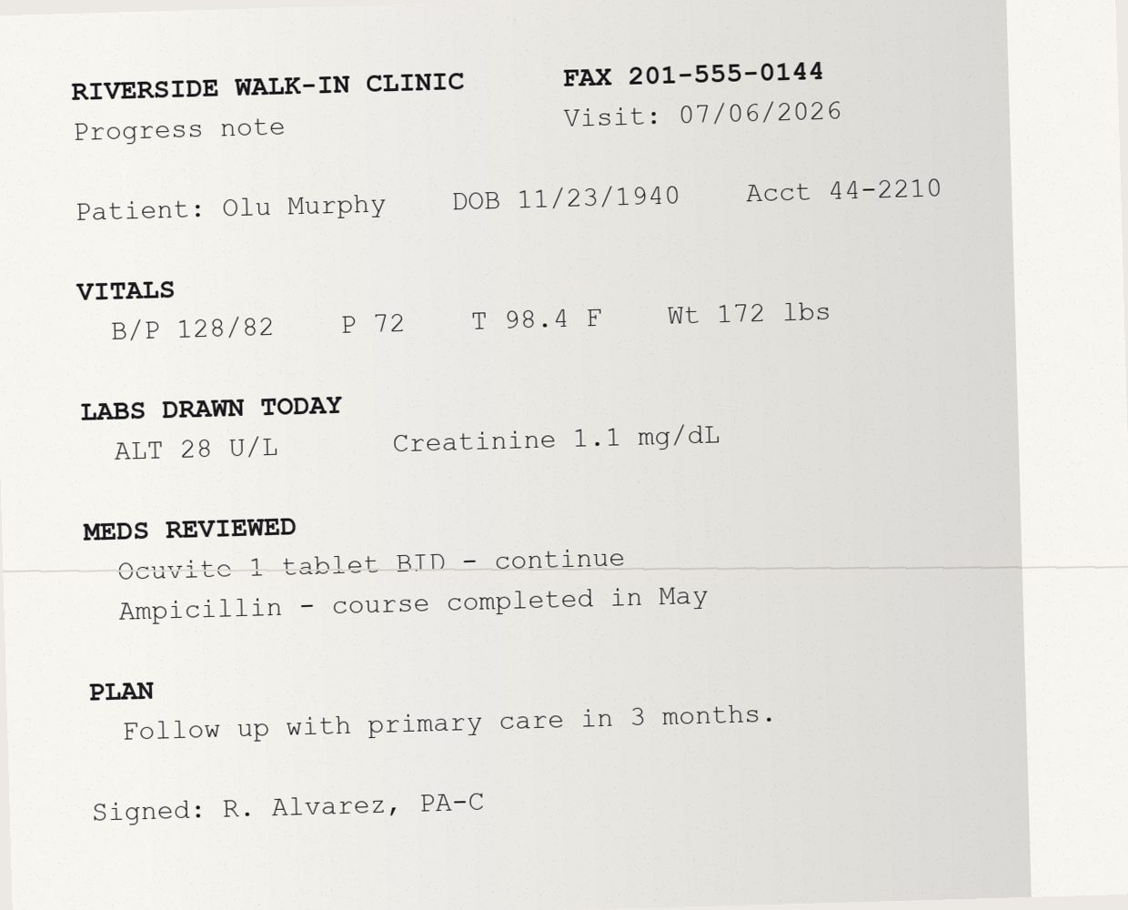
04 · LIVE DEMO
A faxed photo → 10 cited facts in 8 seconds
Field | On the form | Quote
BP | 128/82 | “B/P 128/82”
Pulse | 72 | “P 72”
Temp | 36.9 °C | “T 98.4 F”
Weight | 78.0 kg | “Wt 172 lbs”
ALT | 28 U/L | “ALT 28 U/L”
Ampicillin | Stopped | “completed in May”
05
Notes:
The part no connector reaches: a photo of a fax from a walk-in clinic. The model transcribes it, then reads it under a strict schema that forces a verbatim quote for every value, located back to a page and character span. Highlighted rows: pounds became kilograms, Fahrenheit became Celsius, and the original wording stays attached. Synthetic patient — no real data anywhere.

Slide 6

05 · HOW IT WORKS
Any record to a signed form, in five steps
Follow one value: the weight on the faxed note
1 · AI
2 · RULES
3 · RULES
4 · RULES
5 · HUMAN
Read
Store
Fill
Verify
Sign
Faxes, scans, FHIR become facts with quotes
Every source lands in one patient record
The record fills the trial form, units converted
Every field re-checked against every source
A person resolves flags and exports to the trial database
Agrees with hospital scale
weight · Jul 6 · fax pg 1
Weight: 78.0 kg
Signed · sent to EDC
“Wt 172 lbs”
Only step 1 uses AI — every step after it checks the one before, so a model error can't reach the form
06
Notes:
Walk the five steps left to right, following the weight from the fax on the previous slide. 1, Read: the model (gpt-4.1 or Gemini Flash) runs under a strict JSON schema and must quote every value verbatim; the quote "Wt 172 lbs" is located to page 1. 2, Store: the fact lands in the patient's ledger on Tiger Data with its receipt. 3, Fill: rules map it to the CDASH Vital Signs form using LOINC codes and convert 172 lb to 78.0 kg. 4, Verify: an independent pass checks plausible range, that the quote matches the value, and that sources agree within three days — here it matches the hospital's scale from the day before. 5, Sign: the coordinator sees only flags, decides each with a reason, signs, and exports ODM. Only step 1 is a model; everything after is deterministic, testable rules.

Slide 7

06 · WHEN SOURCES DISAGREE
Flagged and explained — never guessed
FLAGGED · Weight
Causes it can name
78.0 kg · Hospital EHR
Unit mix-up (lb vs kg)
Transposed digits
Med list missing a stop
Off the patient's own trend
87.0 kg · Clinic note, page 2
Likely cause: transposed digits
Example flag
07
Notes:
The verifier is an independent second pass. When sources disagree it says who recorded what, where and when, names the likely cause from rules — unit arithmetic first, then digit patterns, then the patient's own history — and suggests a decision. Here, 87.0 is out of line with this patient's other readings and 78.0 fits them. The coordinator accepts, picks the other source, or enters a value, with a reason. Signing requires a decision on every flagged field.

Slide 8

07 · THE PROOF
Structured data stalls at ~70% — reading closes the gap
WHAT RESEARCH SHOWS
WHAT WE MEASURED
68%
99.7%
17%
of trial data moved automatically
TransFAIR · BMJ HCI 2023
structured only
with the reader · fields filled
Recall on new document layouts
43%
of data points sit in structured EHR
Regex
0.7%
Flatiron & Sanofi · AMIA 2025
Sourced
100%
100%
35/35
0
~70%
of form data a live connector fills
accurate
conflicts caught
false alarms
Mount Sinai · 2026
08
Notes:
Three independent sources agree structured data alone stalls. TransFAIR (BMJ Health and Care Informatics, 2023; 3 hospitals, 3 sponsors) moved about 17 percent of trial data automatically. Flatiron and Sanofi (AMIA Informatics Summit, 2025) found only 43 percent of data points come from structured EHR data, with another 28 percent needing unstructured sources. Mount Sinai's live EHR-to-EDC connector (2026) auto-fills about 70 percent of form data and cut entry from 5.5 to 2.5 minutes a visit. Our own structured-only baseline lands at 68 percent — right where Mount Sinai is. With the reader, 99.7 percent. On 60 patients and 1,009 fields with a known answer key: 100 percent accurate, all 35 planted conflicts caught, zero false alarms. Against a real regex extractor on document layouts it wasn't written for: 0.7 percent recall versus 100.

Slide 9
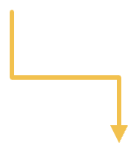
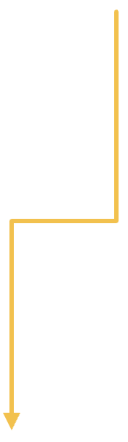
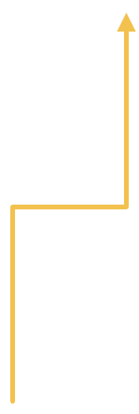

08 · BUILT FOR THE AUDIT
Every receipt answers a regulator
Attributable
SOURCED · RECEIPT
Accountable
ALCOA+ · FDA eSource
ICH E6(R3)
Where every value came from
VALUE ...... 78.0 kg
A person signs, with a reason per flag
SOURCE ..... fax, page 1
QUOTE ...... “Wt 172 lbs”
CHECKED .... range, units
SIGNED ..... coordinator
Original
Tamper-evident
HASH ....... 9f3a…c21e
ALCOA+
21 CFR Part 11
The exact words, kept verbatim
FHIR · LOINC · CDASH · ODM
Every action hash-chained
09
Notes:
Each line of a Sourced receipt maps to something regulators already require. Attributable (ALCOA+, FDA eSource guidance): the source document and page. Original: the verbatim quote, kept beside the converted value. Accountable (ICH E6(R3)): a human signs, with a decision and reason on every flagged field. Tamper-evident (21 CFR Part 11): every action lands in an append-only, SHA-256 hash-chained audit trail that can be re-verified on demand. And it speaks what sites already run — FHIR R4 in, LOINC codes, CDASH forms, ODM out. The hash shown is illustrative. Synthetic data only; it fills and checks — it doesn't diagnose or decide eligibility.

Slide 10




09 · WHY REGENERON
The first data agent on your site-agent map
SITE AGENTS OUTLINE
Source-to-EDC
Source traceable
Acts once proven
Coordinator signs
Coordinator
Monitor
Data manager
TODAY
TODAY
TODAY
Retypes every visit, days later
Travels on site to compare field by field
Raises queries months later
WITH SOURCED
WITH SOURCED
WITH SOURCED
Reviews only the flags
Verifies with one click
Conflicts caught at fill time
10
Notes:
On Regeneron's site-agent map, this is the source-to-EDC data agent — named as the first data agent to build, with one must-have: original source cited and traceable. The outline asks for an agent that acts alone once proven, with the study coordinator accountable. Our metrics are the proof; the sign-off is the accountability. Then the three people whose day changes: the coordinator stops retyping, the monitor verifies from the receipt instead of traveling, and the data manager sees conflicts at fill time instead of months later.

Slide 11




10 · ON TIGER DATA
One Postgres holds the whole ledger
Hypertable
Compression
Aggregates
pgvector
Every fact over time, per patient
Old history shrinks, still queryable
Live chart, refreshed incrementally
Find the fax that mentions a drug
22 / 24
chunked by observed_at
time_bucket('1 day')
384-dim HNSW index
chunks compressed
RUNS ON
Tiger Cloud
PostgreSQL 18
TimescaleDB 2.30
pgvector 0.8
11
Notes:
A clinical ledger is time series, relational rows, JSON and vectors at once; Tiger Cloud holds all four in one Postgres. The facts hypertable is chunked by observed time, so the nearest-to-visit query touches only overlapping chunks. Old chunks compress by policy, segmented by patient: 22 of 24 in our load, still queryable in place. The live chart is a continuous aggregate with one-day buckets per organization. Document search is a 384-dimension HNSW index in the same database — no separate vector store. Receipts are JSONB; the audit trail is a second hypertable with a hash chain.

Slide 12


11 · WHAT'S NEXT
From proof to a site's daily tool
01
02
03
04
Fax & EHR intake
Live EDC export
Scans at volume
Acts alone once proven
Documents flow in on their own
Signed forms land in the trial database
A site's whole paper backlog
Stops asking about fields it gets right
12
Notes:
Next: connectors for fax servers and EHR document exports, a real EDC export target, scanned PDFs at volume — and the autonomy switch from Regeneron's outline: an agent that earns autonomy field type by field type and stops asking about the ones it has been right about. The receipts and the metrics are what make that switch safe to flip.

Slide 13
SOURCED · RESULTS
The model reads
FIELDS FILLED .... 99.7%
ACCURACY ......... 100%
CONFLICTS ........ 35/35
The rules fill and check
FALSE ALARMS ..... 0
NEW LAYOUTS ...... 100%
The human signs
EVERY VALUE: A RECEIPT
SIGNED BY: a human
Sourced
github.com/AyaanFaisal21/HackRUF26
Notes:
Close on the three lines. The receipt on the right recaps what we measured: 99.7 percent of fields filled, 100 percent accurate, 35 of 35 planted conflicts caught, zero false alarms, 100 percent recall on new layouts — every value with a receipt, every form signed by a human. The repo reproduces every number from a clean clone. Happy to open the demo live.

